Slide 1
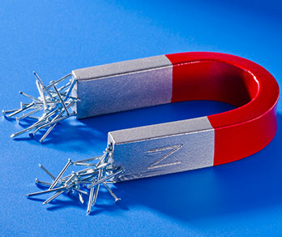
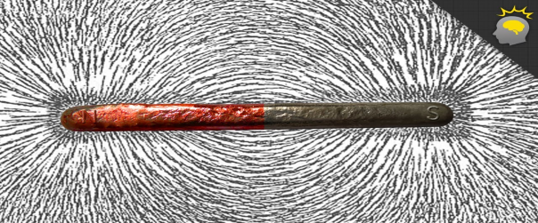
MAGNETIC FORCE
The most common magnets are made of Iron (Fe). They may also include Steel, Nickel (Ni), Cobalt (Co).
The side of the magnet that points north (red) is called its North Pole – the other side (blue) is its South Pole. This is because the Earth has a magnetic core.
Rule: Opposites attract. Like poles repel.
Around the magnet is its magnetic field, in which its force can be felt.
Invisible field lines run from North to South.
They do not cross each other.
Where they are more concentrated, it has a higher force.
Magnets are used in: Computers. Speakers. PhotoStatting machines. X-ray machines. Generators for electricity. Electromagnetic cranes. Credit cards. DoorBells. Phones.

Slide 2
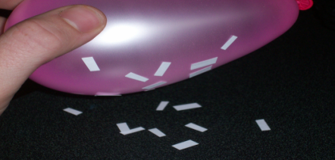
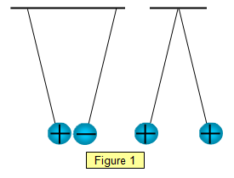
ELECTROSTATIC FORCES
ElectroStatic Forces form when two electrically charged objects have a force of attraction or repulsion, without touching each other.
In a neutral object, the number of positives equals the number of negatives.
If you rub extra electrons off an object, it becomes positively charged.
If you rub extra electrons onto an object, it becomes negatively charged.
(See page 50 for how to charge different rods.)
Rule: Opposites attract. Like charges repel.
Reminder: Wind can rub electrons off one cloud, and onto another cloud. These extra electron can now jump from the negative cloud to the positive cloud. We call this LIGHTNING. (Earth can also be part of this.)

Slide 3
QUESTIONS Page 105
Question 1 10 X [1] = [10]
Force 2. Distortion 3. Deceleration
4. Balanced forces 5. Gravitational force 6. Shear
7. Torsion 8. Friction 9. Gravity 10. Magnetic field
Question 2
Start it moving. Make it move faster. [2]
Its mass is what it is made up of. Its weight is the force with which it is attracted to the earth. [4]
M = 10 kg g = 10 W = ?
W = m X g = 10 X 10 = 100 N [3]
4. (a) Friction [1] (b) Stops you from slipping. Can use it to sharpen knives. Cars use brakes to slow down. [3]
5. Tension. Bending. Compression. Torsion. Shear. [4]

Slide 4
Question 3
Acceleration. Deceleration. Direction change. Distorts an object by changing its shape. [4]
2. m = 50 kg g = 10 W = mg = 50 X 10 = 500 N [3]
3. (a) Unbalanced forces. One is higher than the other. [3]
(b) 320 – 300 = 20 N force, pulling to the left. [2]
Question 4
Gravitational force. [1]
Any two objects with mass has a gravitational force of attraction between them. [3]
3. Mass. The distance between them. [2]
Earth is 6 times larger than Moon, so its force of attraction on that person is 6 times greater. [4]

Slide 5
(Still) Question 4
5. (a) m = 60 kg g = 10 W = mg = 60 X 10 = 600 N [3]
(b) m = 60 kg g = 1,6 W = mg = 1,6 X 10 = 96 N [3]
All objects fall with the same acceleration, regardless of their mass. [2]
10 m/s faster, each second (= 10 m/s²) [3]
(a) Moon’s force of gravity attracts sea water towards it. [3]
(b) Sun & planets stay the same in mass, gravity, distance, movements. [3]
Question 5
1. Iron. Steel. Nickel. Cobalt. [4] 2. Over a distance. [1]
3. (a) ⬅ N ➔ ➔ S ⬅ [2]
(b) Area around magnet, in which influence of magnet can be felt.
4. repel . . . attract [2]
5.(a) Generators. Motors. Trains. ElectroMagnets. (b) Fridge magnets. Credit cards. Phones. Doorbells. (c) X-ray. MRI. (d) Hard-drives. Speakers. [4]

Slide 6
Question 6
(a) B (b) A (c) C [3]
A and C. Opposite charges attract. [3]
Electroscope. [1]
C [1]
Wind blows inside cloud. Particles rub against each other. Electrons are rubbed off it, or onto it. Positively charged clouds attract electrons, negatively charged clouds release electrons. These moving electrons form lightning. [5]
Avoid trees, water, metal fences, landline phones, window areas. Unplug TV and computers. [3]

